Slide 1

Identification of Drug-addicted People Using Short Length of Voice Signal Through Haar and Symlet Wavelet Transform
Dr. Md. Rafiqul Islam Professor Mathematics Discipline Khulna University ,Khulna-9208.

Slide 2

Outlines
Introduction Different type of wavelets Disorders of drug use Methodology Results and discussion Conclusion References

Slide 3

Objectives
To identify the key features of the human voice who are addicted to alcohol, cannabis, or both and also non-addicted.
Applying wavelet transformation for denoising and smoothing the collected raw data.
Extracting features using (Haar, Sym2) wavelet.
we calculated PSNR and SNR values to identify the difference between their voice signals.
Evaluating the model and predicting the outcome for new data.

Slide 4

Introduction
Voice recognition is a technique that identifies constitutional and unconstitutional voice signals automatically. Human beings can hear the frequency range from approximately 20Hz to 20,000Hz.
The Wavelet Transform (WT) is a modern parameterization method that has been used successfully for some signal processing tasks. Wavelets are powerful statistical tools that can be used for a wide range of applications, namely
Signal processing
Data compression
Smoothing and denoising
Speech recognition
Pattern recognition, etc.

Slide 5

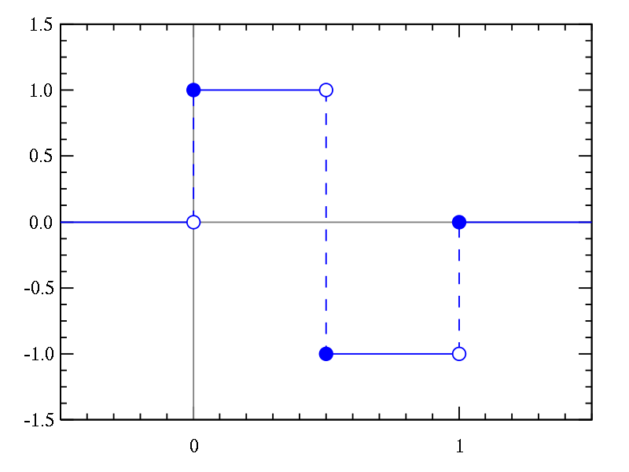
Different Kinds of Wavelet
Haar Wavelet
The Haar sequence was proposed in 1909 by Alfred Haar. Haar used these functions to give an example of an orthonormal system for the space of square-integrable on the unit interval [0, 1]
Haar wavelet is defined as
Figure: Haar Wavelet

Slide 6

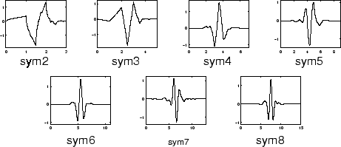
Different Kinds of Wavelet
Symlet Wavelet
The Symlets are nearly symmetrical wavelets proposed by Daubechies as modifications to the DB family. The properties of the two wavelet families are similar. Here are the graphical representation of Symlet wavelet:
Figure: Symlet Wavelet

Slide 7

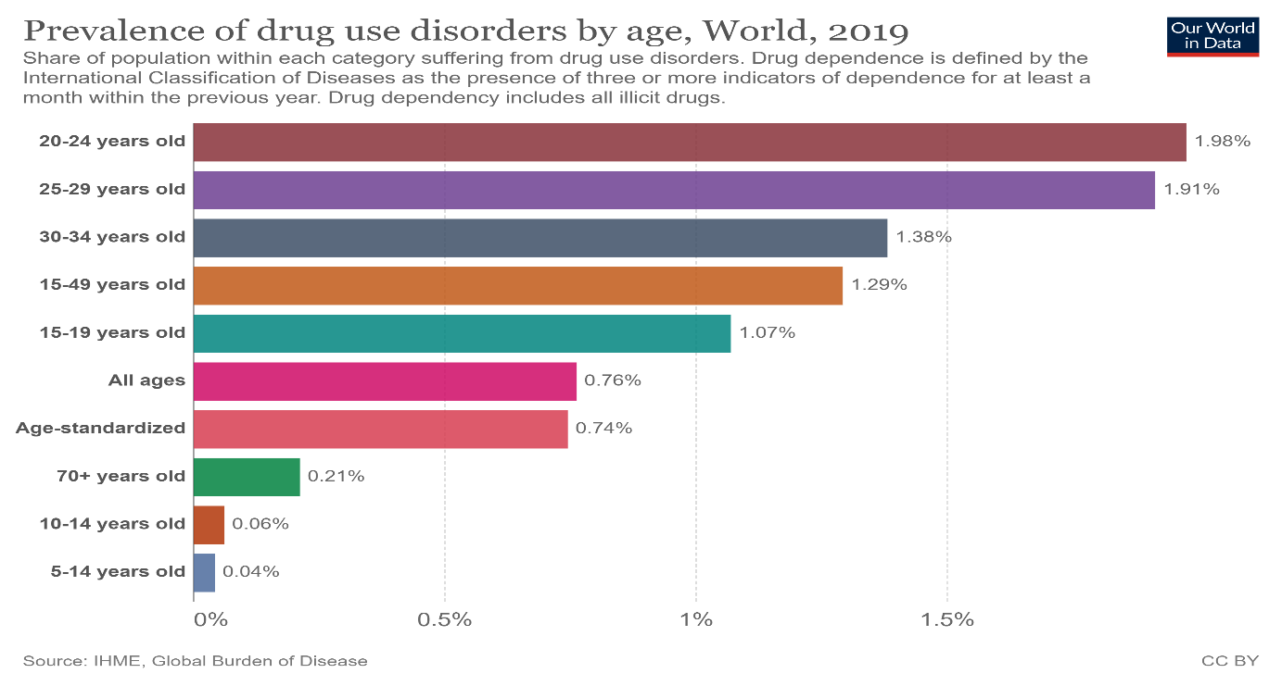
Disorders of drug use
Figure : Prevalence of drug use disorders by age, world, 2019

Slide 8

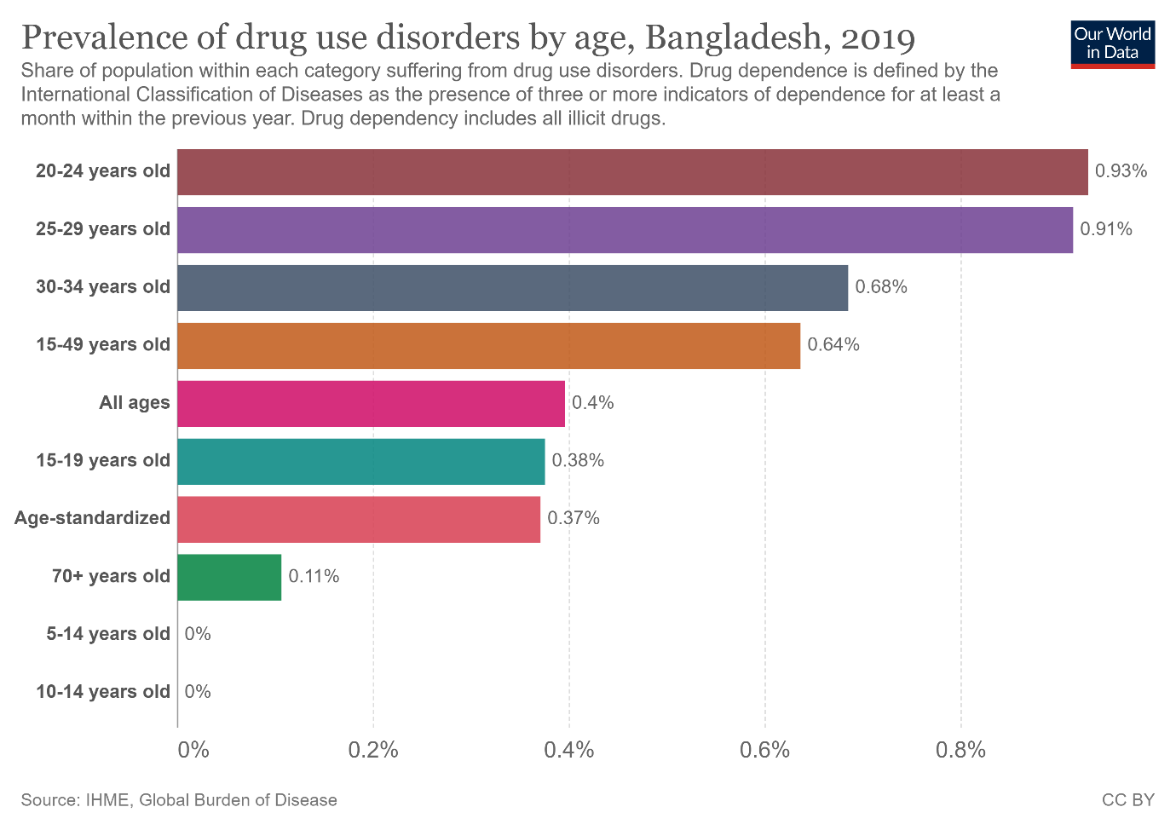
Disorders of drug use
Figure: Prevalence of drug use disorders by age, Bangladesh, 2019

Slide 9
Methodology
Collecting Voice Data
Processing
Denoising and Smoothing collected voice
Extracting Features using(Haar,Sym2) Wavelet
Find out PSNR and SNR value
Predicting Output

Slide 10

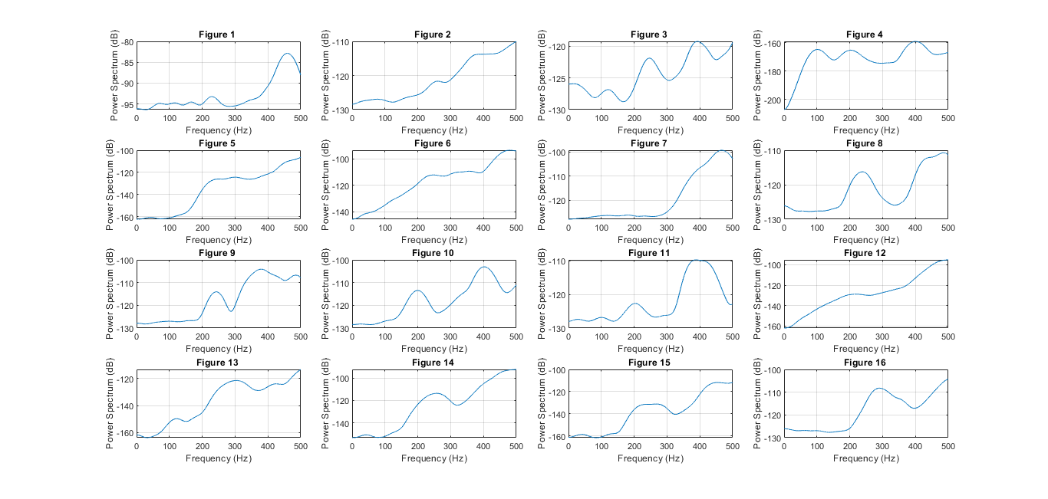
Result and Discussions
The power spectrum for Addicted People’s voice signal for different wavelet
Sym2 Wavelet
Figure: Wavelet Features of Voice of Addicted people using Sym2 wavelet

Slide 11
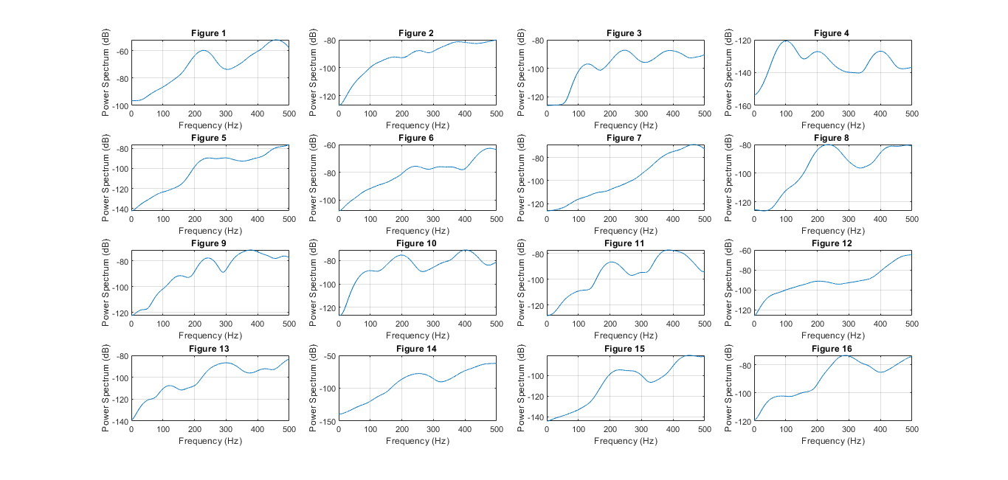
Result and Discussions
Haar Wavelet
Figure: Wavelet Features of Voice of Addicted people using Haar wavelet

Slide 12

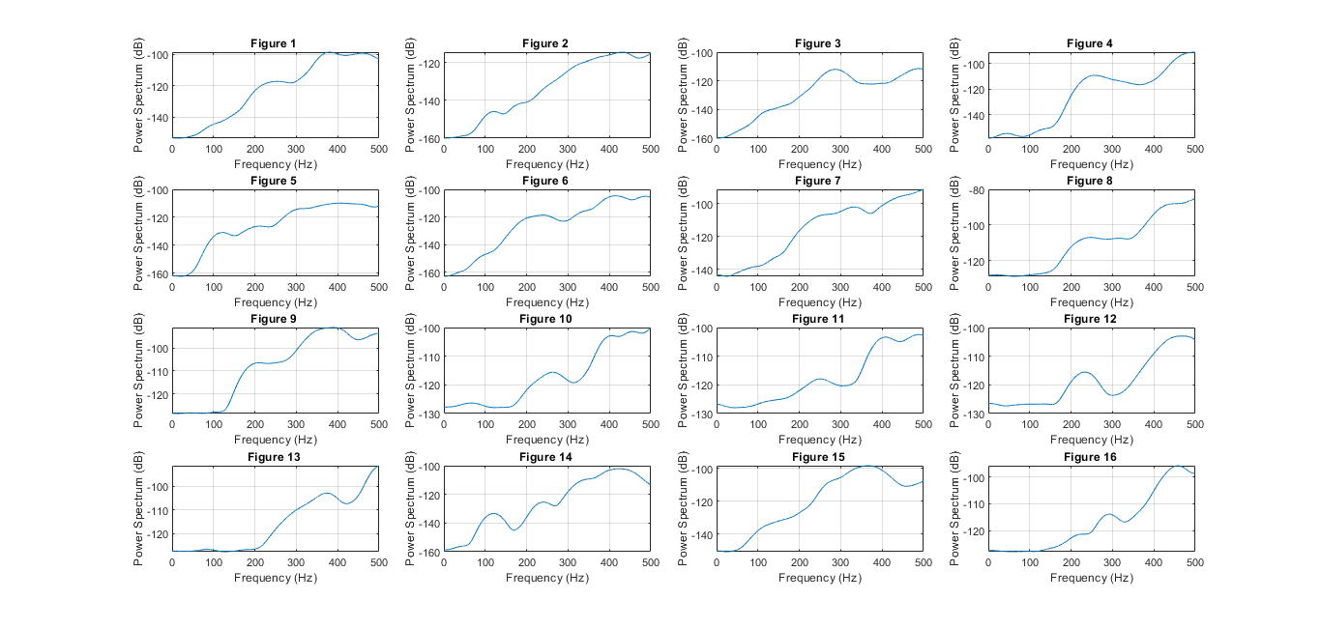
The power spectrum for Non-addicted People’s voice signal for different wavelet
Result and Discussions
Sym2 Wavelet
Figure: Wavelet Features of Voice of Non-addicted people using Sym2 wavelet

Slide 13

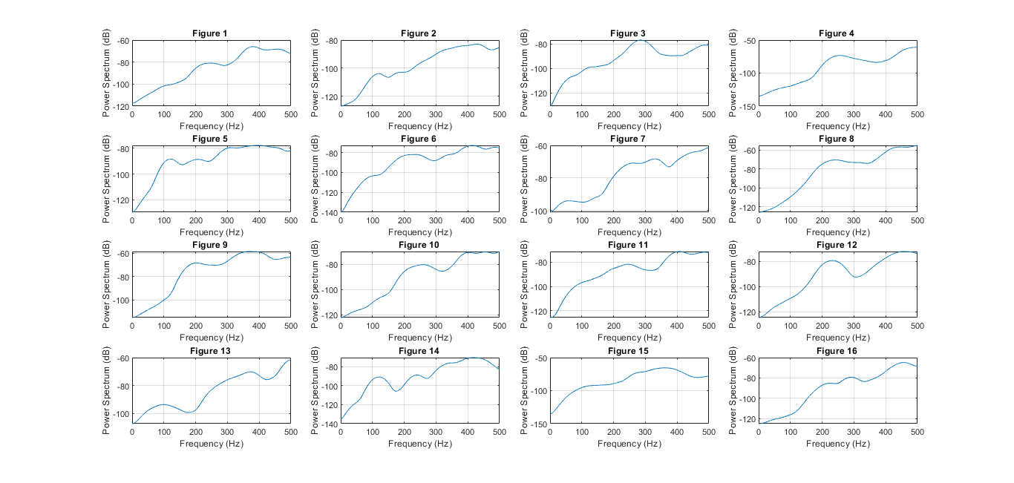
Result and Discussions
Haar Wavelet
Figure: Wavelet Features of Voice of Non-addicted people using Haar wavelet

Slide 14

Result and Discussions
Findings
In most cases, the power spectrum starts from 0 for non-addicted and for addicted power spectrum starts not from 0.
Comparing different wavelets, Haar wavelet gives a better result.

Slide 15

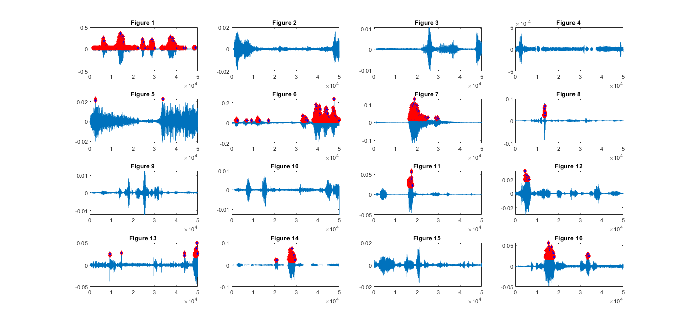
Result and Discussions
Peaks of wavelet features for Addicted People’s voice from different wavelet
Sym2 Wavelet
Figure: Wavelet Features of Voice for Addicted people using Sym2 wavelet

Slide 16

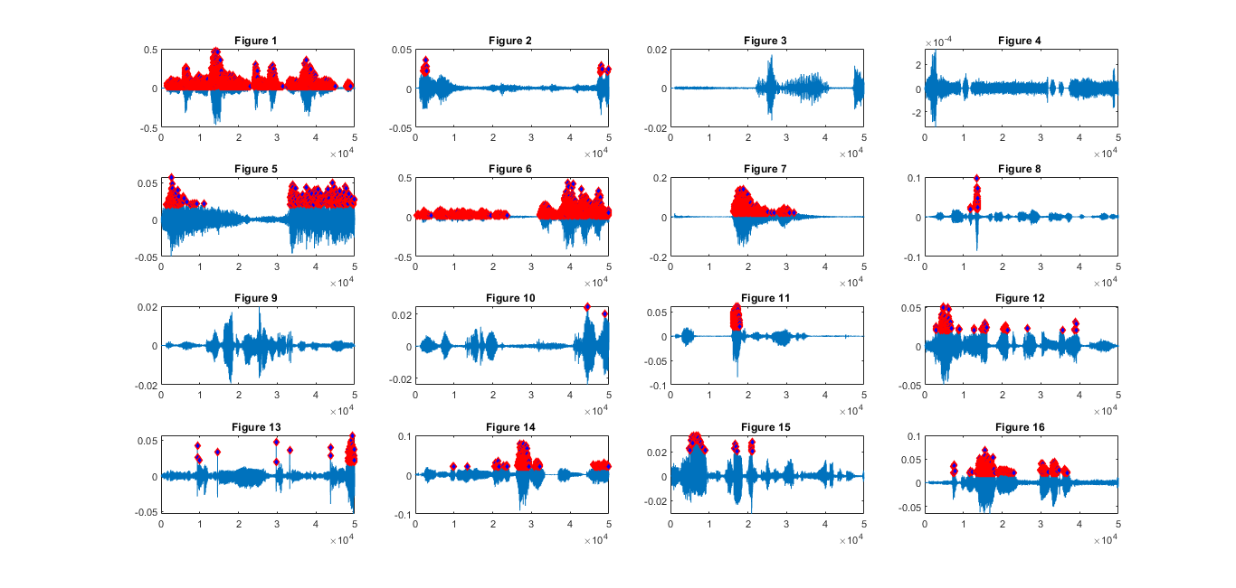
Result and Discussions
Haar Wavelet
Figure: Wavelet Features of Voice for Addicted people using Haar wavelet

Slide 17

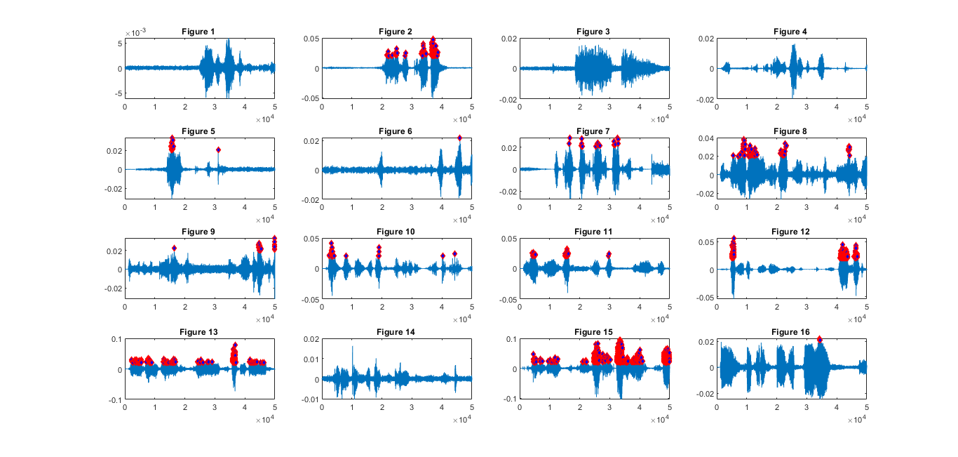
Result and Discussions
Peaks of wavelet features for Non-addicted People’s voice from different wavelet
Sym2 Wavelet
Figure: Wavelet Features of Voice of Non-addicted people using Sym2 wavelet

Slide 18
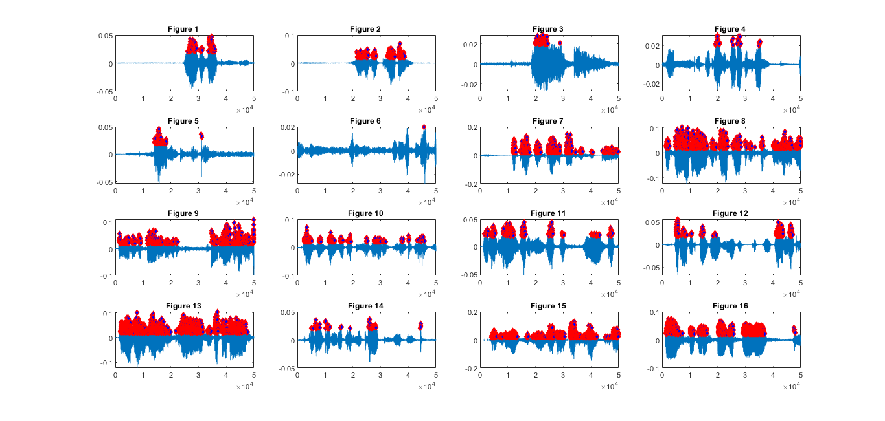
Result and Discussions
Haar Wavelet
Figure: Wavelet Features of Voice of Non-addicted people using Haar wavelet

Slide 19

Result and Discussions
Findings
We find that in those people who are addicted to alcohol or cannabis, the wavelet spectrum value is higher than non-addicted.
For addicted people, the high spectrum length is greater than non-addicted people.

Slide 20

Result and Discussions
Calculation PSNR and SNR value for Non-addicted People
Table-1
Wavelet name | PSNR | SNR
Haar | (34.70-35.20) | (21.40-22.30)
Sym2 | (32.25-33.90) | (19.10-20.80)
Calculation PSNR and SNR value for Addicted People
Table-2
Wavelet name | PSNR | SNR
Haar | (36.60-37.10) | (25.20-26.30)
Sym2 | (34.50-35.90) | (22.30-23.70)

Slide 21

Result and Discussions
Findings
From Table-1 and Table-2, we can see that the peak signal to noise ratio (PSNR) and signal to noise ratio (SNR) values for Haar wavelet are higher than Sym2 for non-addicted and addicted people. So, we only take the PSNR and SNR values of the Haar wavelet.
For non-addicted people, the value of PSNR ranges from 34.70 to 35.20 and the value of SNR ranges from 21.40 to 22.30. Also, for drug-addicted people, the value of PSNR ranges from 36.60 to 37.10 and the value of SNR ranges from 25.20 to 26.30.

Slide 22

Conclusion
After graphical analysis of the voice of addicted and non-addicted people, we can say that the Haar wavelet is more realistic than Sym2 wavelet.
For non-addicted people, the value of PSNR ranges from 34.70 to 35.20 and the value of SNR ranges from 21.40 to 22.30. Also, for addicted people, the value of PSNR ranges from 36.60 to 37.10 and the value of SNR ranges from 25.20 to 26.30.
Nowadays we identify drug-addicted people by the dope test which is an expensive and timely process. But identifying drug-addicted people by using their voice is a short time process and it’s not expensive.

Slide 23

Limitations of our work
We only worked with male voices
We have only worked with 16 drugs-addicted and 16 non-addicted people’s voices
People must speak under normal circumstances
There is an obligation to take the voice in English

Slide 24

References
Hossain M. S. and Islam M. R., (2015), “Human Voice Activity Detection using Wavelet”, J Appl Computat Math, 4(3).
Allen JB .,(1994), “How do humans process and recognize speech?” Speech Aud Proces IEEE Trans, 2(4):567–77..
Tanyer S. G. and Özer H., (2000), “Voice Activity Detection in Non-stationary Noise”, IEEE Trans, Speech and Audio Processing, 8(4).
Jayashree B. M., Pooja N. S., and Hiremath S. G., (2015), “Processing of speech signal using wavelet transform and support vector machine”, International Journal of Science, Engineering and Technology Research (IJSETR), 4(8).
Kumar S., Shastri A., and Singh R. K., (2011), “An Approach for Automatic Voice Signal Detection (AVSD) Using Matlab”, International Journal of Computer Theory and Engineering, 3(2).
Nemer, E., Goubran R., and Robust S., (2001), “Voice Activity Detection Using Higher-Order Statistics in the LPC Residual Domain”, IEEE Trans. Speech and Audio Processing, Vol. 9, 217-231.
Chen S. H. and Wang J. F., (2002), "A Wavelet-based Voice Activity Detection Algorithm in Noisy Environments", IEEE International Conference on Electronics, 995998.

Slide 25

References
Stegmann J. and Schroder G., (1997), "Robust voice-activity detection based on the wavelet transform", IEEE Workshop on Speech Coding for Telecommunications Proceeding, Vol. 09, 99 – 100.
Alex J. and Bernhard S. O., (2004), “A tutorial on support vector regression”, Kluwer Academic Publishers, Vol. 14, 199–222.
Simon G., Tobias H., Markus B. and Gerhard S., (2015), “Features for voice activity detection: a comparative analysis”, EURASIP Journal on Advances in Signal Processing, 9(7).
Naziya S. and Deshmukh R. R., (2016), “Speech Recognition System – A Review”, IOSR Journal of Computer Engineering (IOSR-JCE), 18(4).
Roser, H. R. (2019). Opioids, cocaine, cannabis and illicit drugs. Retrieved from Our World in Data: https://ourworldindata.org/illicit-drug-use
Shazzad MN1, A. S. (2013, November 2). Drug Addiction in Bangladesh and its Effect. p. 84-87.

Slide 26
THANK YOU

